Slide 1
Measuring things which are very fast or very small… like light waves
Bobcat Summer STEM Seminar 2023
Prof. Dustin Kleckner

Slide 2

What are we going to do?
1.Measure the speed and wavelength of sound
2. Measure the speed and wavelength of light
3. Learn everything we need to do 1 and 2

Slide 3
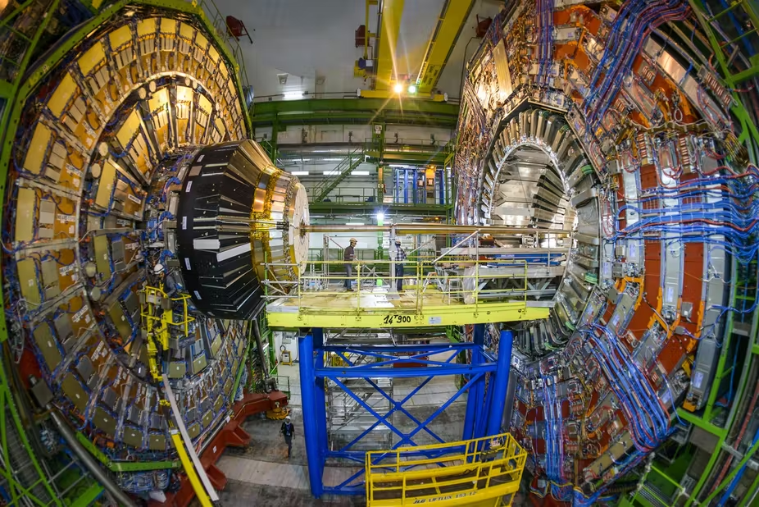
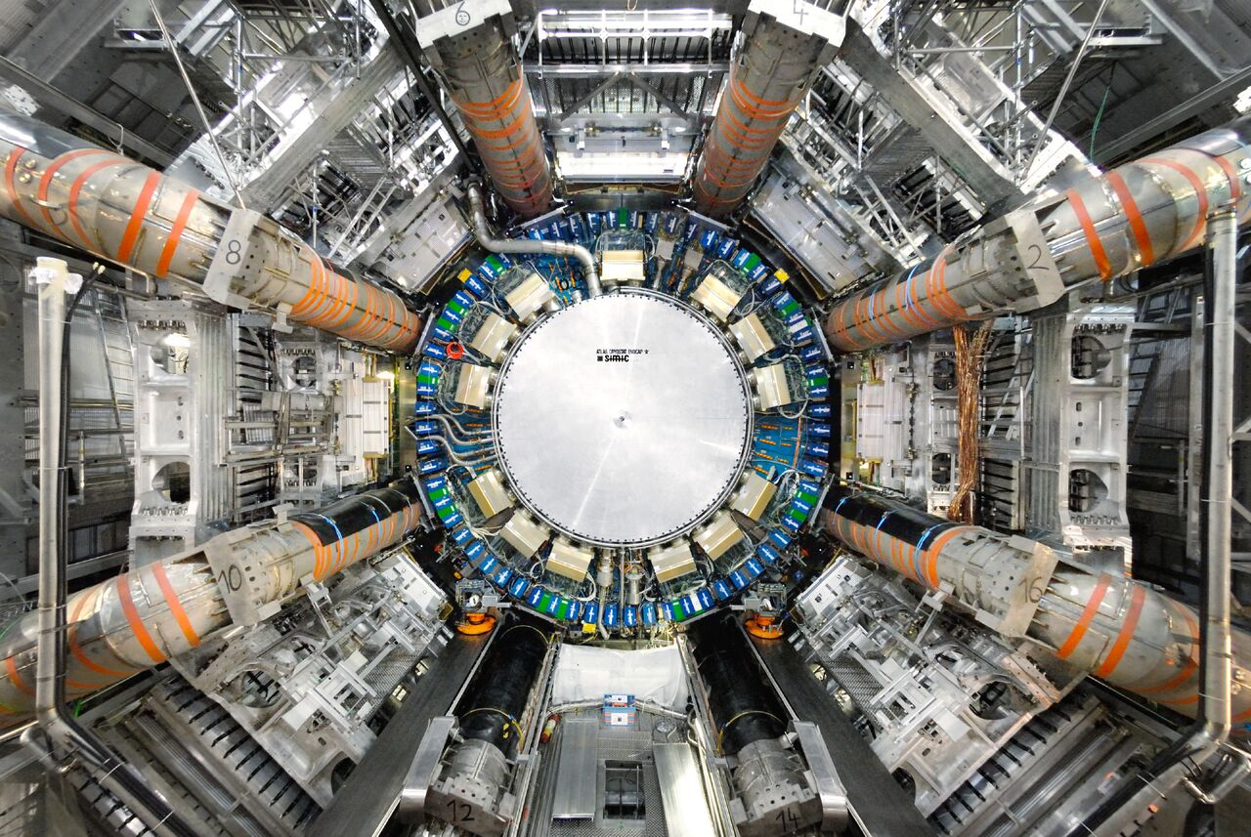
How do you measure things you can’t see?
You build things that can see them!

Slide 4
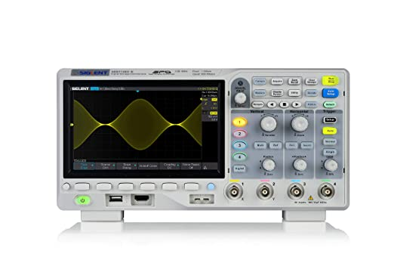
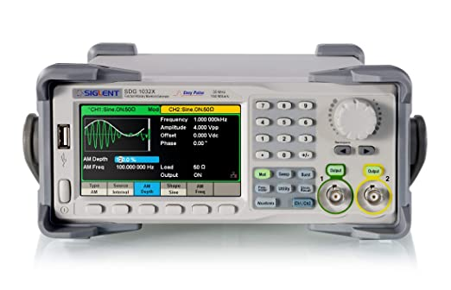
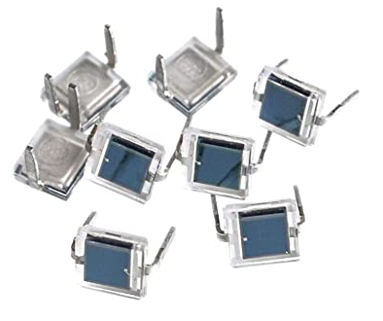
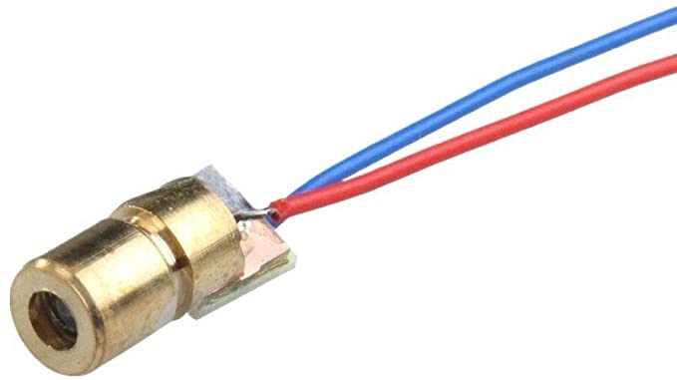
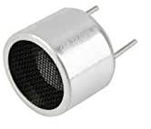
What do we need to learn?
Oscilloscope: measure electrical signals (“waveforms”)
Basic electronics: turn electric signals to/from sound, light, etc
Function generators: create electrical signals
Units and big numbers: how to represent physical things
What are waves?
3 × 10⁸ m/s = 0.98 ft/ns

Slide 5
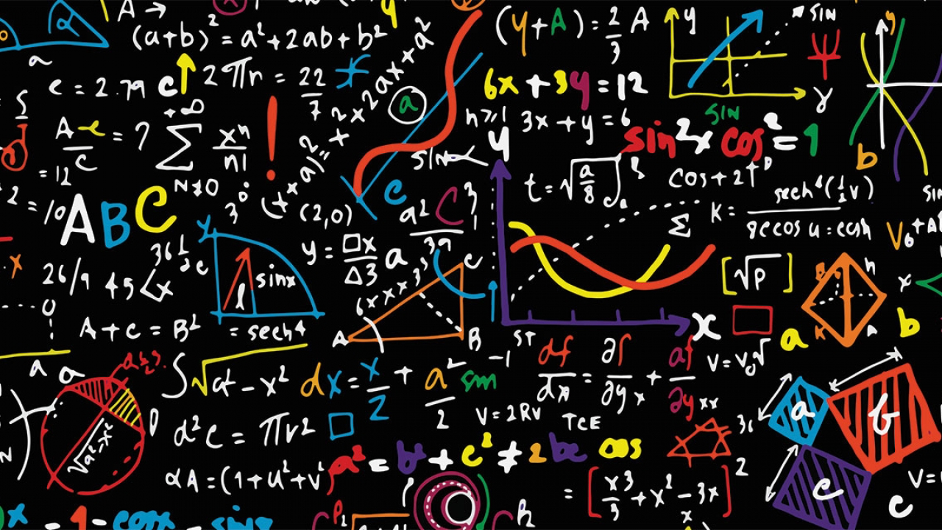
Which Math/Science classes have you taken?
Algebra?
Geometry?
Calculus?
Physics?

Slide 6
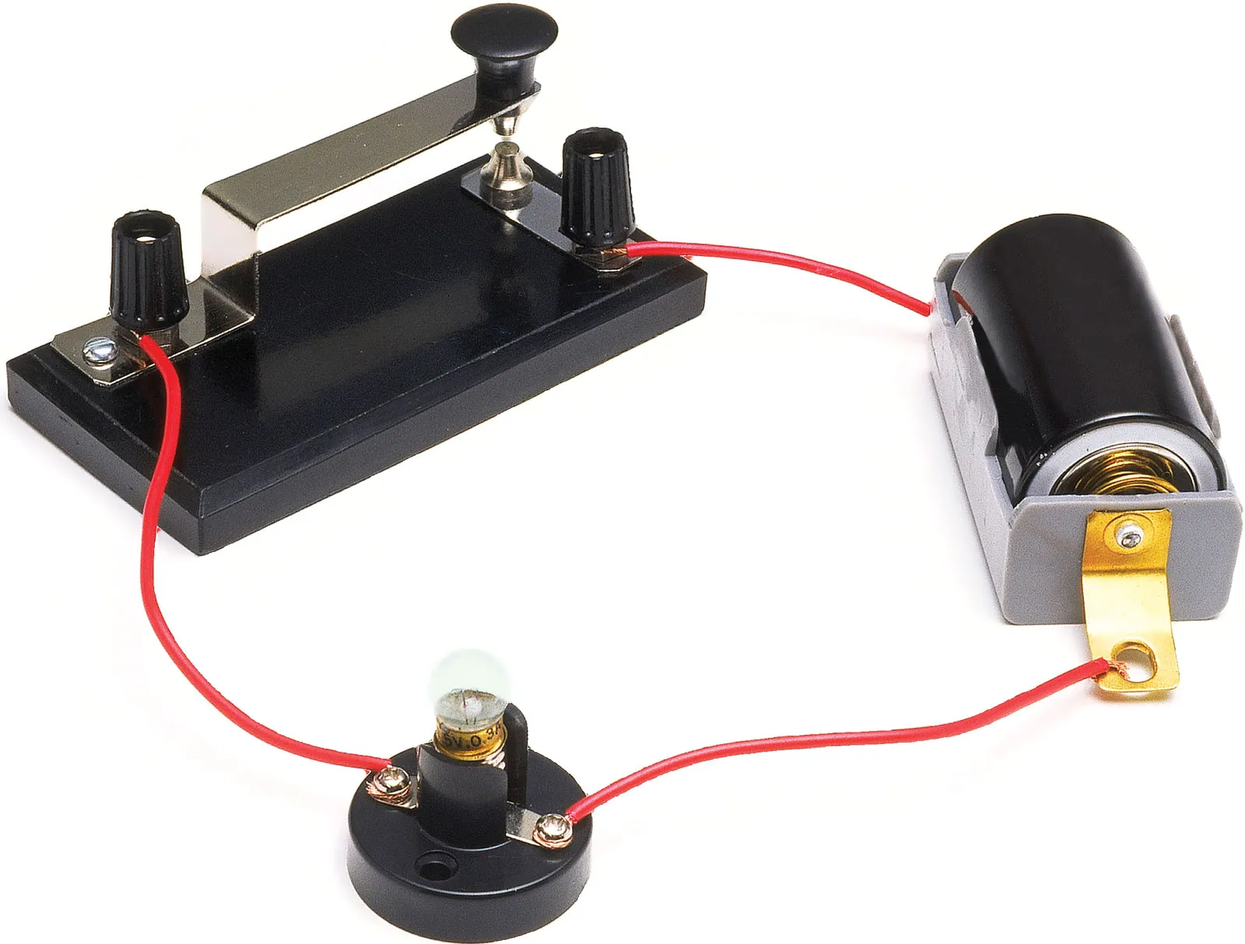
Have you ever…
Used an oscilloscope?
Used a function/signal generator?
Made an electronic circuit?

Slide 7

What’s a wave?
Examples?
Water waves (fluid surface waves)
Sound waves (pressure waves in a gas)
Light wave (electromagnetic waves)
Mechanical waves (e.g. from earthquakes)
In quantum mechanics, literally everything is a wave
Each oscillates in time and space
Can be described by things like “amplitude”, “frequency”, “period”, and “velocity”

Slide 8
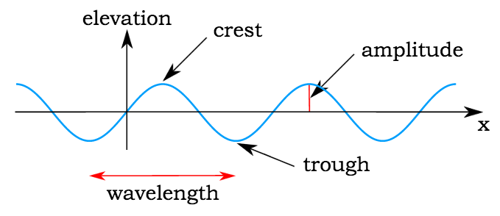
Features of a wave
Velocity
Amplitude (A, meters)
Wavelength (λ, meters)
Period (T, seconds)
Frequency (f, Hz)
Velocity (v, m/s)
Note: sometimes amplitude is measured “peak-to-peak”, instead of from center to peak

Slide 9
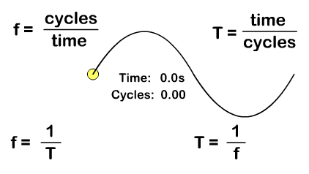
Frequency and Period
Frequency: The number of wave cycles completed in one second. It is represented by “f” and measured in hertz (Hz = 1/s).
Period: The time to complete one full wave cycle. It is represented by “T” and measured in seconds (s).

Slide 10
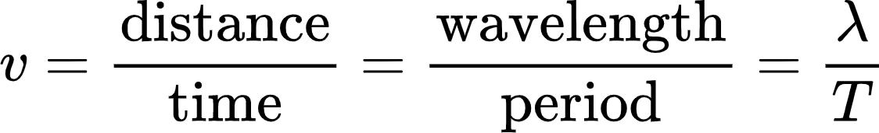
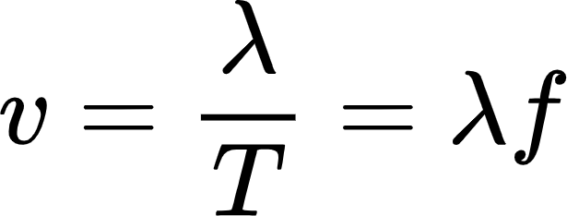
Velocity of a wave
If velocity is distance per unit time, then the same will apply to waves.
We use wavelength to measure the distance that a wave travels in one cycle, and period to measure the time that a wave takes to complete that cycle. So velocity will be represented by the following:
But since we know that period and frequency are inversely related, we can also write:

